Slide 1

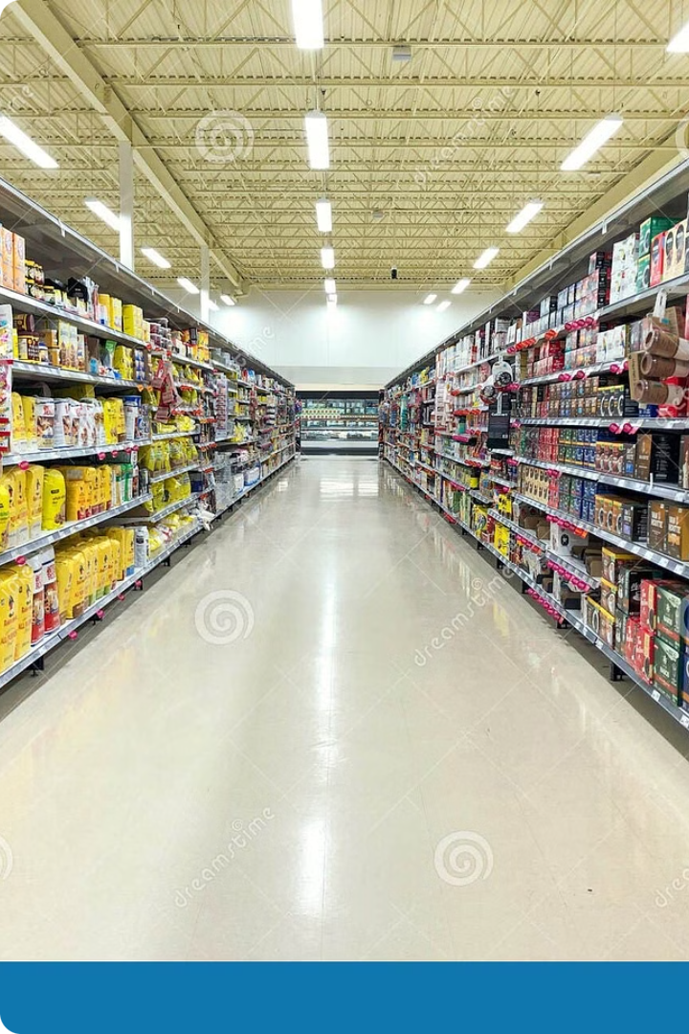
Market Basket Analysis
Market basket analysis is a powerful technique used to discover relationships and patterns among items purchased by customers. This information can be used to improve business strategies and enhance customer experience.
U
by G.Uday (192210472)

Slide 2

What is Market Basket Analysis?
Understanding Customer Behavior
Uncovering Associations
Market basket analysis analyzes customer purchase data to identify items frequently bought together.
It reveals hidden relationships between products, revealing what customers typically buy in combination with specific items.

Slide 3

Natural Language Processing (NLP)
Natural Language Processing (NLP) is a branch of artificial intelligence that focuses on the interaction between computers and human language. NLP techniques enable computers to understand, interpret, and generate human language.

Slide 4
Data Requirements for Market Basket Analysis
Transaction Data
Product Data
Customer Data
Detailed records of each customer purchase, including items bought, quantities, and timestamps.
Information on each product, such as category, brand, price, and description.
Optional, but helpful for segmenting customers and personalizing recommendations.

Slide 5
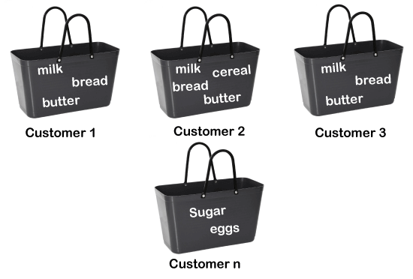
Association Rule Mining
1
Frequent Itemset Generation
Identifying itemsets that occur frequently in transactions.
2
Rule Generation
Forming association rules based on the frequent itemsets.
3
Rule Evaluation
Assessing the quality of rules using metrics such as support, confidence, and lift.

Slide 6
Frequent Itemset Generation
Itemset
Support
Bread, Milk
0.25
Milk, Eggs
0.18
Bread, Cheese
0.15

Slide 7

Conclusion and Key Takeaways
Market basket analysis provides valuable insights into customer behavior, enabling businesses to optimize pricing, promotions, and product placement strategies for increased sales and customer satisfaction.

Slide 8

Summary
Market basket analysis is a statistical technique used to identify relationships between products purchased together. It explores transactional data to
find associations and patterns, revealing which items tend to be bought in combination. This analysis helps retailers understand customer behavior,
improve product placement, optimize pricing strategies, and facilitate cross-selling opportunities. By leveraging this data, businesses can enhance
marketing efforts, personalize recommendations, and ultimately increase sales and customer satisfaction.

